Slide 1
Section 11.2 Series
Lecture 1
Beginning Ideas

Slide 2
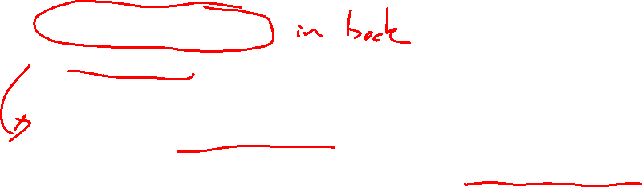
Section 11.2 Homework Submission to Canvas
Preview of section​
Skim section, write short paragraph summary, list all important definitions / theorems / formulas.​
Notes on video lectures​
Include all details, worked examples, your own thoughts​
Worked examples from text​
Solutions to exercises​
Final reflection of section​
List of key takeaways to remember​

Slide 3
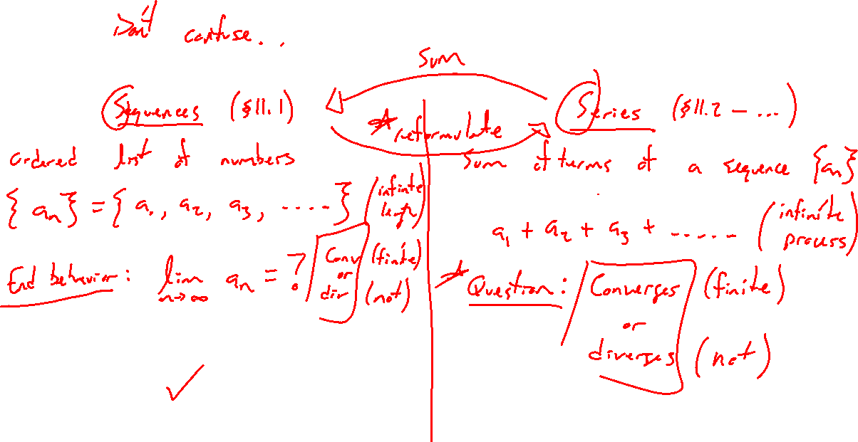
Sequence vs Series
Notes:
Example: 1+1/2+1/4+1/8+ …
Sequence is an ordered list (collection)
Series is an infinite sum (process)
Relation goes both ways, series is sum of a sequence, series can be writing of a limit of sequence

Slide 4
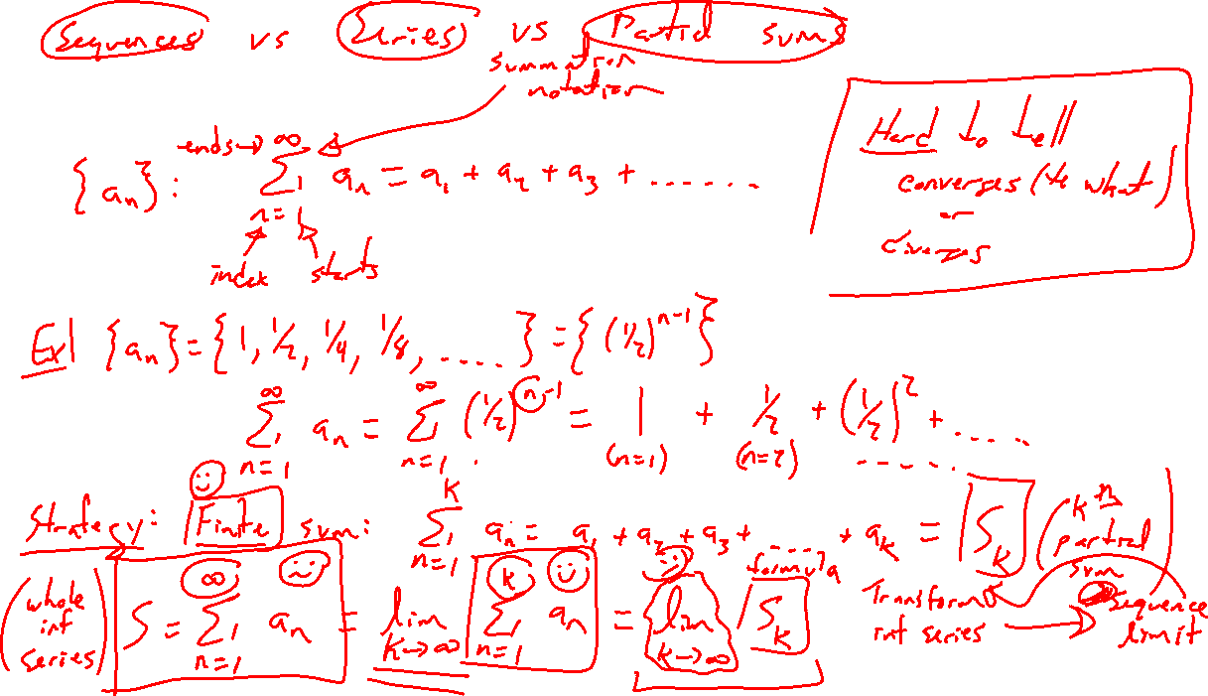
Series Notation
Notes:
1 + ½ + ¼ + … = summation notation
Hard to attack directly, instead do a finite sum and write as a limit of a partial sum
Keep terminology straight: sequence, series, limit of partial sum

Slide 5
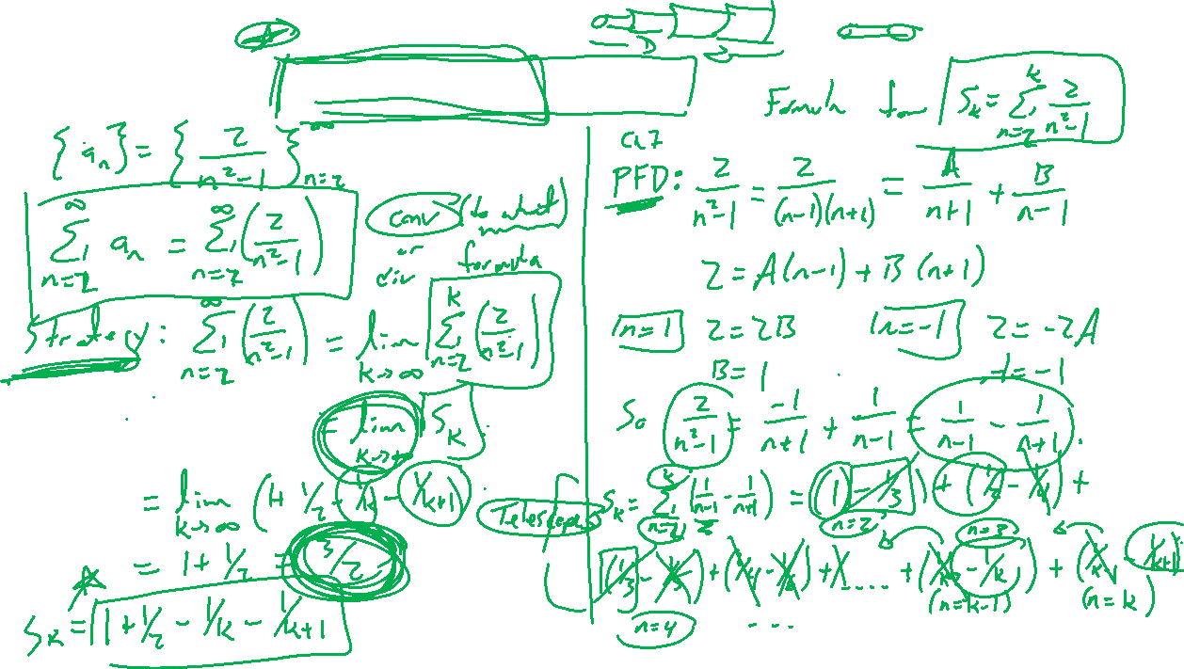
Example: Telescoping Series
Notes:
a_n = 2/(n^2-1) = -1/(n+1)+1/(n-1) via partial fraction decomposition
Write out S_1, S_2, S_3, … , S_k and see cancelling
Series as limit of partial sum

Slide 6
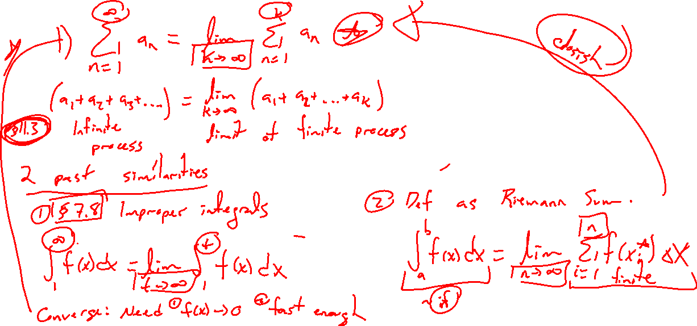
Intuition of an Infinite Series
Notes:
Seen this idea before: Series as limit of partial sum
Area of limit of Riemann sum
Improper integral as limit of def integral
Can an infinite sum of nonzero numbers be finite? Yes from last example. Similar paradox with improper integrals.

Slide 7
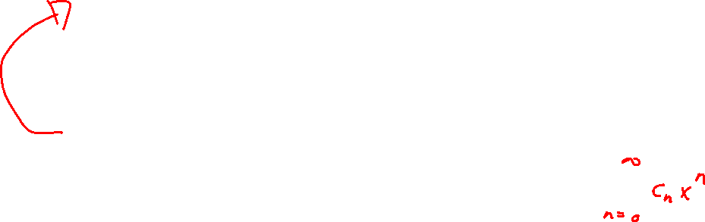
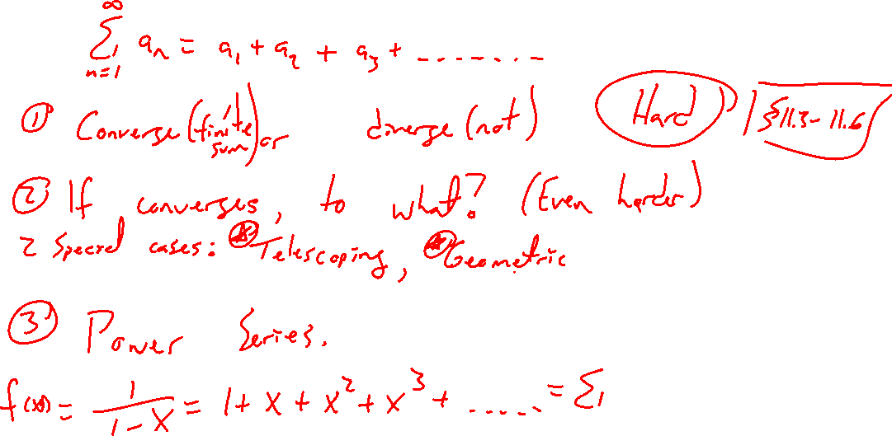
Question of an Infinite Series
Notes:
Converge yes or no? Already hard. Will relate this question to existing calculus knowledge (series tests).
If converge, what to? Cannot do most of the time. Cases can handle…
- Telescoping series, geometric series, power series are important cases.
Main task is to understand series to build theory of power series at end of chapter.

